Slide 1
C A R D A T A S E T
NAME : SHALINI NAPIT
Project overview:
Dataset comprises car details like names, selling prices, km driven, fuel types, mileage, engine displacement[cc], and maximum power.
Objective is to analyze relationships between these attributes and make prediction or recommendations
Tasks include data cleaning, exploratory analysis, feature engineering, modeling, and evaluation

Slide 2
Dataset and Project overview:
Data set: car dataset featuring attributes such as car’s names, selling prices, km driven, fuel types, mileage, engine displacement[cc], and maximum power.
Project objective: Analyze factors influencing car selling prices and performance metrics like mileage and power.
significance
The analysis offers valuable insights into car pricing, fuel efficiency, and performance, guilding strategic decision in product development, pricing strategies, and marketing efforts within the automotive industry.

Slide 3
Dataset overview:
The dataset comprises car attributes like names, selling prices, km driven, fuel types, mileage, engine displacement[cc], and maximum power, facilitating analysis performance metrics.
key columns:-
Transmission : The type of transmission (manual or automatic).
Owner : The number of previous owners of the car.
Mileage : The mileage of the car in kilometers per liter.
Engine [CC] : The engine displacement in cubic centimeters (CC).
Max Power : The maximum power output of the car's engine.
Seats : The number of seats in the car.
Name : The name or model of the car.
Year : The manufacturing year of the
Selling Price : The price at which the car was sold.
Km Driven : The number of kilometers driven by the car.
Fuel : The type of fuel the car uses.
Seller Type : The type of seller (individual, dealer, or Trustmark dealer).

Slide 4
The SQL queries and methos used involve:
1. Reading the whole table of the Dataset
2. Counting the total number cars present in the dataset
3. Show the all tyeps of fuel used in this dataset
4. Counting the total number of Petrol Fuel use
5. Read the maximum selling price from the dataset
6. Read the minimum selling price from the dataset
7. Read the Average selling price in this dataset
8. Calculate the average milege
9. What is the maximum seats of the car
10. Read 2 most car available in this dataset

Slide 5
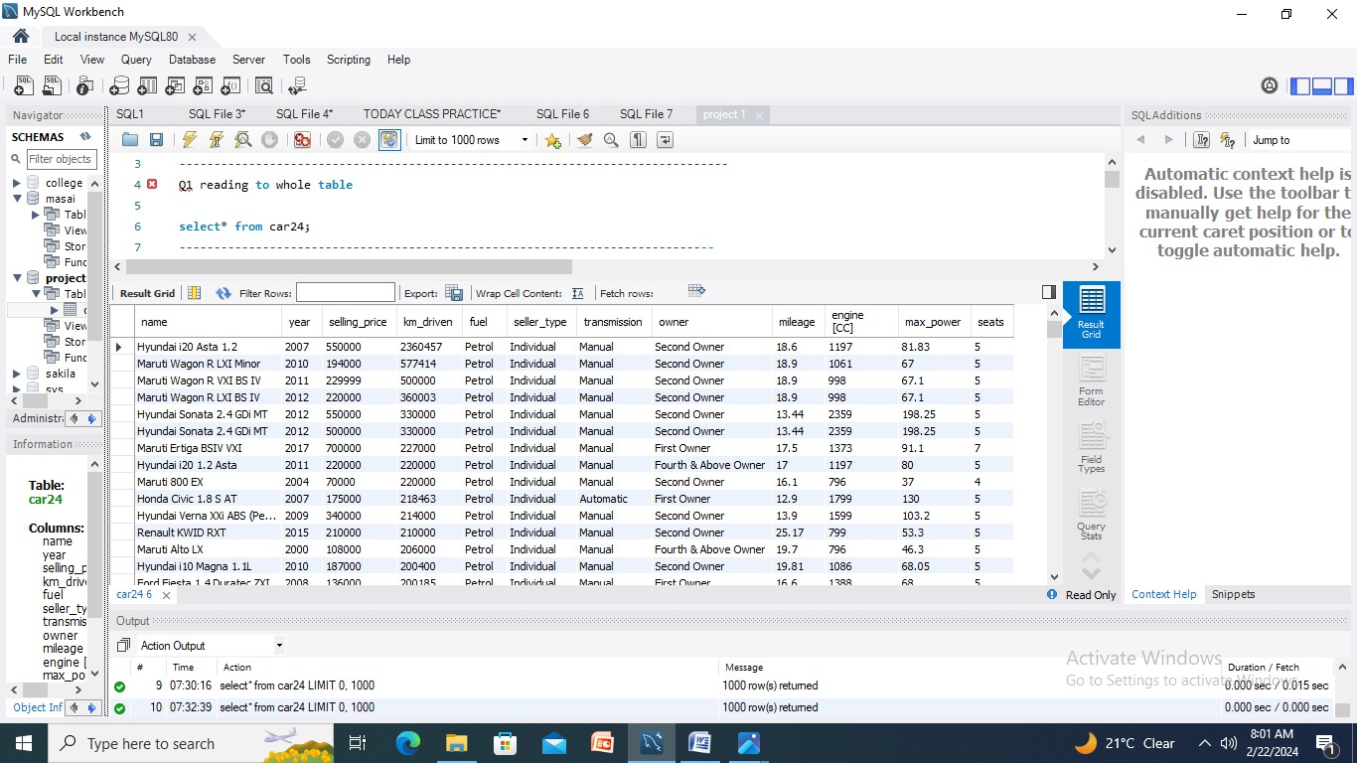
Read the whole table of the dataset

Slide 6
1. Counting the total number cars present in the dataset
8,128 DATA
Total this number of data

Slide 7
All types of fuel
Diesel – 4402
Petrol – 3631
CNG – 57
LPG - 38

Slide 8
Maximum selling price
10,000,000
Minimum selling price
29999

Slide 9
Average selling price
638271.8077

Slide 10
Average milage
19

Slide 11
Maximum seats of the car
14

Slide 12
conclusion
Reading the whole table of the Dataset
Counting the total number cars present in the datase
Show the all tyeps of fuel used in this dataset
Read the maximum selling price from the dataset
Read the minimum selling price from the dataset
Read the Average selling price in this dataset
Calculate the average milage
What is the maximum seats of the car

Slide 13
Challenges:
Data quantity issues like missing values or inconsistencies.
Handling categorical variables like fuel type effectively in analysis.
Dealing with outliers that could skew analysis results.
Lessons learned:
Importance of thorough data cleaning and preprocessing.
Need for domain knowledge to interpret findings accurately
Iterative appproach to modeling and analysis for better results.

Slide 14
Potential future direction:
Potential future directions include exploring advanced modeling techniques, refining feature engineering , segmenting analysis for tailored strategies, predicting maintenance needs, integrating external data developing interactive dashboards, implementing continuous monitoring and incorporating customer sentiment analysis.

Slide 15
THANK YOU

